Slide 1

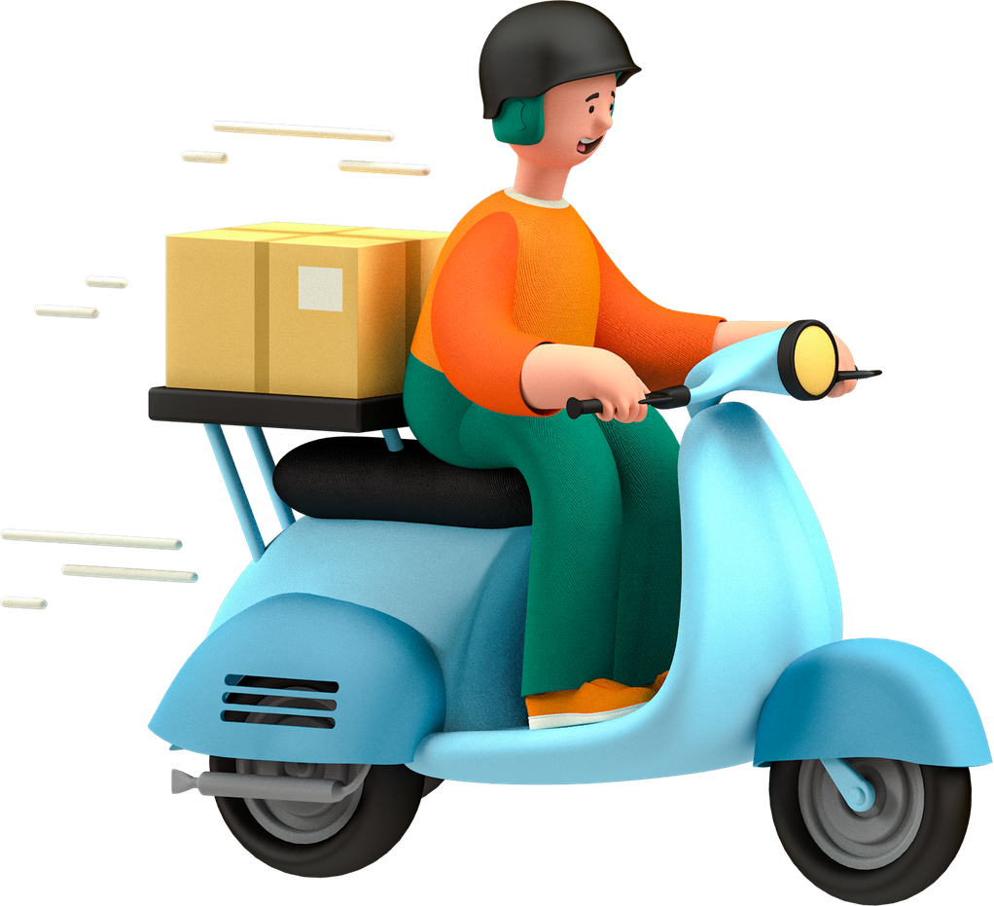

Delivery Route Optimizer
Presented by
M. Laasya Sri 2520090196
M. Rajini 2520090197

Slide 2

Abstract
Helps logistics companies plan efficient delivery routes.
Takes customer addresses and delivery details as input.
Cleans incorrect, duplicate, or incomplete address data.
Assigns delivery stops to vehicles based on vehicle capacity.
Considers delivery time windows.
Finds routes with less distance and travel time.
Reduces fuel consumption and transportation cost.
Provides optimized routes and route-quality reports.

Slide 3

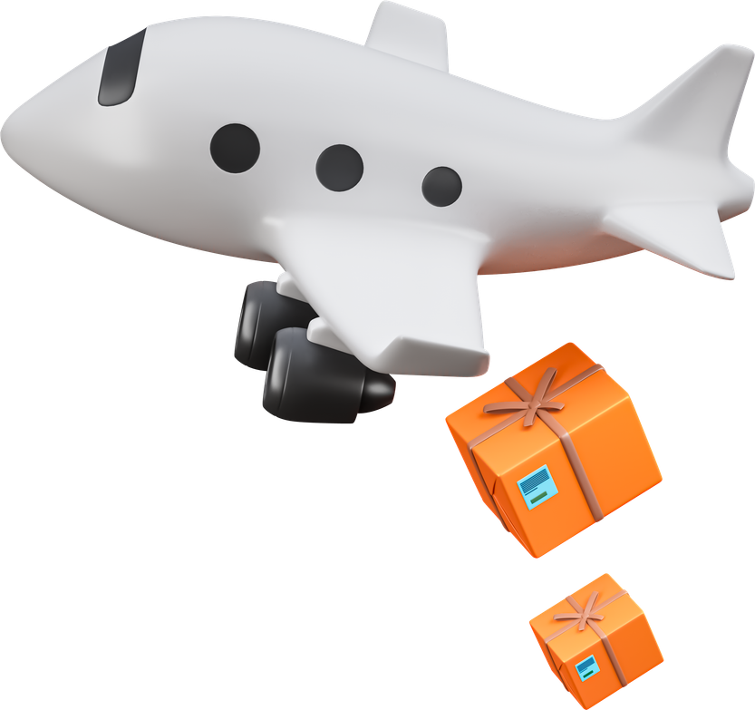
Introduction
  Logistics companies handle a large number of delivery locations every day.
  Poor route planning can increase travel distance, fuel consumption, delivery time, and operational costs.
  Delivery addresses may contain incomplete, duplicated, or inconsistent information.
  Vehicle capacity and customer delivery time windows add additional constraints.
  Finding the exact optimal solution for large routing problems is computationally expensive.
  Therefore, the proposed system uses data cleaning and approximation-based route optimization to generate practical and efficient delivery routes.

Slide 4

Software Requirements
Software Requirement
Operating System Windows 10/11 or Linux
Programming Language Python
Frontend HTML, CSS, JavaScript
Back Python Flask
Database MySQL / SQLite
IDE / Editor Visual Studio Code
Mapping Service OpenStreetMap / Google Maps API
Geocoding Geocoding API for converting addresses to . coordinates
Libraries Pandas, NumPy, OR-Tools
Browser Google Chrome / Microsoft Edge
Version Control Git / GitHub

Slide 5

Hardware Requirements
Hardware
Minimum Requirement
  Processor
  RAM
  Storage
  Display
  Internet
  Keyboard
  Mouse
  Network
Intel Core i3 / AMD Ryzen 3 or above
4 GB minimum, 8 GB recommended
10 GB free space
1366 × 768 resolution or higher
Stable internet connection
Standard keyboard
Standard mouse
Wi-Fi / Ethernet

Slide 6

Literature Survey
  Vehicle Routing Problem (VRP): Finds the best routes for vehicles to
visit multiple delivery locations.
  Vehicle Capacity: Routes must be planned without exceeding the carrying
capacity of each vehicle.
  Time Windows: Deliveries must be completed within the customer's specified time.
  Address Data Cleaning: Removes incorrect, duplicate, or incomplete addresses before route planning.
  Route Optimization: Heuristic methods are used to find good routes quickly for large numbers of delivery stops.
  Research Gap: Existing methods often focus on only one part of the problem. Our system combines address cleaning, vehicle assignment, capacity, time constraints, route optimization, and cost reporting in one system.

Slide 7
Methodology
Collect Delivery Data
Clean the Data
Convert Addresses to Locations
Assign Stops to Vehicles
Take delivery details such as customer address, package quantity, vehicle capacity, and delivery time as input.
Remove duplicate, incomplete, and incorrectly formatted addresses to make the data reliable.
Convert the cleaned addresses into latitude and longitude coordinates using a geocoding service.
Distribute delivery stops among available vehicles based on vehicle capacity and delivery requirements.
Optimize Routes
Check Constraints
Calculate Cost and Quality
Display Final Routes
Find an efficient order for visiting the assigned delivery stops using route optimization/heuristic algorithms.
  Vehicle capacity is not exceeded.
  Deliveries are made within the required time windows.
  Unnecessary distance and travel time are reduced.
Show the optimized route for each vehicle on a map along with the cost and quality report.
  Total distance
  Travel time
  Estimated cost
  Vehicle utilization
  Time-window violations

Slide 8
Thank You
Presented By
M. LAASYA SRI
2520090196
M. RAJINI
2520090197

